Slide 1
EDU GRAPH-API Summary
Expertise in Microsoft's Azure, Office 365, and SharePoint platforms

Slide 2
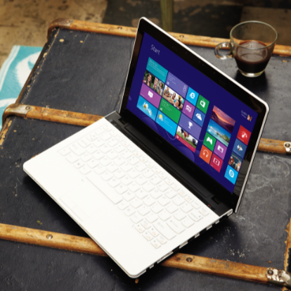
Agenda
Microsoft SSO and the benefits to ISVs
Application Types and Scenarios
Key Auth scenarios
Curated EDU Samples
Add app with Azure AD

Slide 3
A brief outline of Microsoft SSO (Azure Active Directory) and the benefits to ISVs

Slide 4
Azure AD
Azure Active Directory (Azure AD) is Microsoft’s multi-tenant cloud based directory and identity management service.

Slide 5
Azure AD
For IT Admins, Azure AD provides an affordable, easy to use solution to give employees and business partners single sign-on (SSO) access to thousands of cloud SaaS Applications like Office365, Salesforce.com, DropBox, and Concur.

Slide 6
Azure AD
For application developers, Azure AD lets you focus on building your application by making it fast and simple to integrate with a world class identity management solution used by millions of organizations around the world.

Slide 7
Azure AD
A full suite of identity management capabilities
Multi-factor authentication
Device registration
Self-service password management
Self-service group
Management
Privileged account management
Role based access control
Application usage monitoring
Rich auditing
Security monitoring and alerting
…

Slide 8
Light Documentation on OAuth 2 & Open ID connect
Supported Token and Claim Types - Learn about the claims in the tokens that Azure AD issue.
Federation Metadata - Learn how to find and interpret the metadata documents that Azure AD generates.
OAuth 2.0 in Azure AD - Learn about the implementation of OAuth 2.0 in Azure AD.
OpenID Connect 1.0 - Learn how to use OAuth 2.0, an authorization protocol, for authentication.
SAML Protocol Reference - Learn about the Single Sign-On and Single Sign-out SAML profiles of Azure AD.
WS-Federation 1.2 - Learn about WS-Federation 1.2 in Azure AD.

Slide 9
Azure AD
Your organization can use Azure AD to improve employee productivity, streamline IT processes, improve security and cut costs in many ways

Slide 10
Benefits of Azure AD
Quickly adopt cloud services, providing employees and partners with an easy single-sign on experience.
Empower employees with access to world class cloud apps and self-service capabilities from wherever they need to work on the devices they love to use.
Easily and securely manage employee and vendor access to your corporate social media accounts.
Improve application security with Azure AD multifactor authentication and conditional access.
Implement consistent, self-service application access management, empowering business owners to move quickly while cutting IT costs and overheads.
Monitor application usage and protect your business from advanced threats with security reporting and monitoring.
Secure mobile (remote) access to on-premises applications.

Slide 11
Application Types and Scenarios
Five primary application scenarios:
Web Browser to Web Application
Single Page Application (SPA)
Native Application to Web API
Web Application to Web API
Daemon or Server Application to Web API

Slide 12
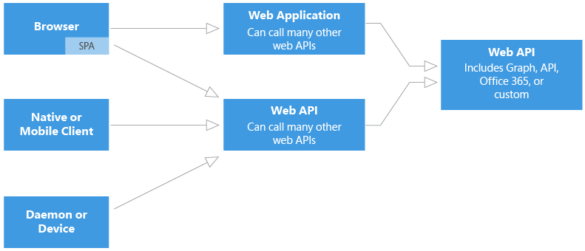

Slide 13
Auth scenarios
Web Browser to Web Application
An application authenticates a user in a web browser to a web application. In this scenario, the web application directs the user’s browser to sign them in to Azure AD. Azure AD returns a sign-in response through the user’s browser, which contains claims about the user in a security token. This scenario supports sign-on using the WS-Federation, SAML 2.0, and OpenID Connect protocols.

Slide 14
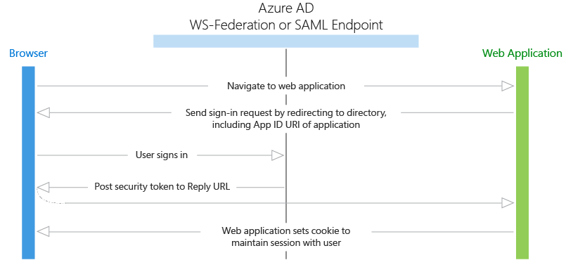

Slide 15
Auth scenarios
Single Page Application (SPA)
A Single Page Application uses Azure AD and the OAuth 2.0 implicit authorization grant to secure its web API back end. Single Page Applications are typically structured as a JavaScript presentation layer (front end) that runs in the browser and a Web API back end that runs on a server and implements the application’s business logic.

Slide 16
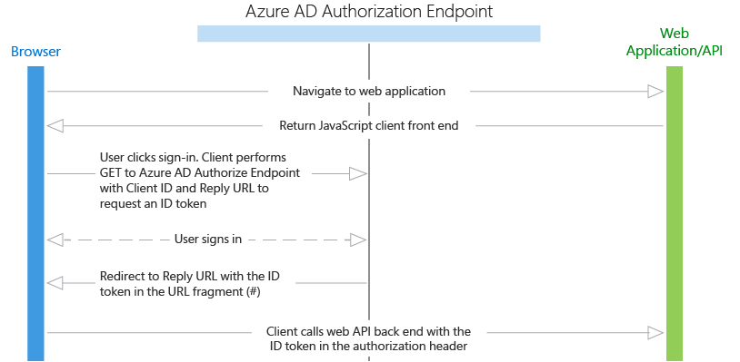

Slide 17
Auth scenarios
Native Application to Web API
A native application that calls a web API on behalf of a user. This scenario is built on the OAuth 2.0 authorization code grant type with a public client. The native application obtains an access token for the user by using the OAuth 2.0 protocol. This access token is then sent in the request to the web API, which authorizes the user and returns the desired resource.

Slide 18
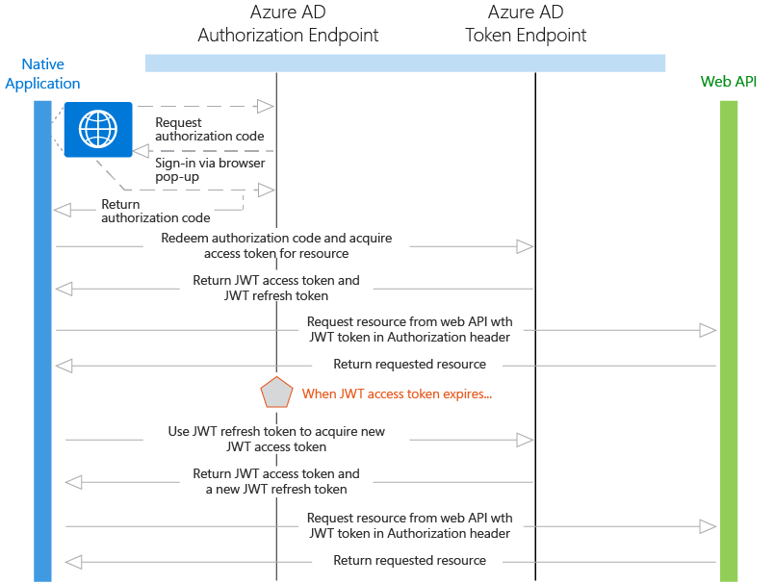

Slide 19
Auth scenarios
Web Application to Web API
A web application that needs to get resources from a web API. In this scenario, there are two identity types that the web application can use to authenticate and call the web API:
Application identity: This scenario uses OAuth 2.0 client credentials grant to authenticate as the application and access the web API.
Delegated user identity: This scenario can be accomplished in two ways: OpenID Connect, and OAuth 2.0 authorization code grant with a confidential client.

Slide 20
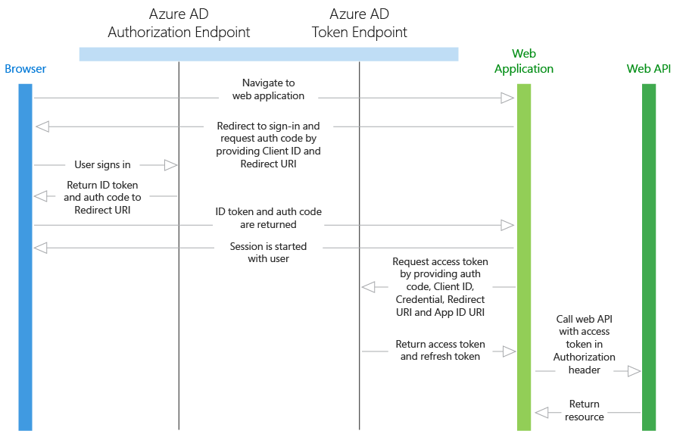

Slide 21
Auth scenarios
Daemon or Server Application to Web API
A daemon or server application that needs to get resources from a web API. There are two sub-scenarios that apply to this section:
A daemon that needs to call a web API, built on OAuth 2.0 client credentials grant type;
A server application (such as a web API) that needs to call a web API, built on OAuth 2.0 On-Behalf-Of draft specification.

Slide 22
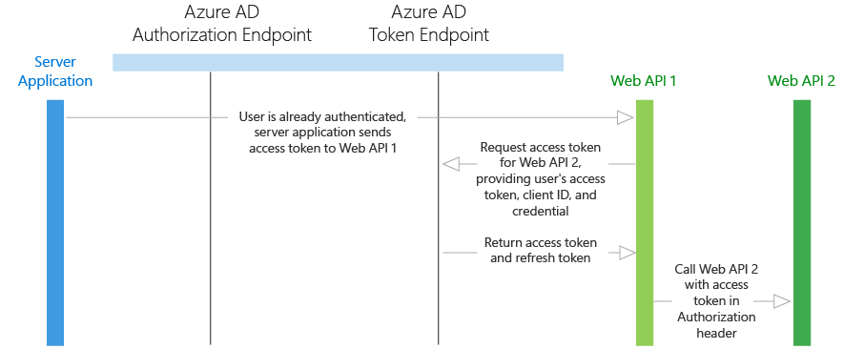

Slide 23
Overview of implementation
We just reviewed the benefits of Azure AD integration and Azure AD authentication scenarios. Below are the other useful articles.
Integrating applications with Azure AD: Learn how to add, update, and remove applications from Azure AD, and about the branding guidelines for integrated apps.
Azure AD Graph API: Use the Azure AD Graph API to programmatically access Azure AD through REST API endpoints. The Azure AD Graph API is also accessible through Microsoft Graph. Microsoft Graph provides a unified API that enables access to multiple Microsoft cloud service APIs, through a single REST API endpoint, and with a single access token.
Azure AD authentication libraries: Easily authenticate users to obtain access tokens by using Azure AD authentication libraries for .NET, JavaScript, Objective-C, Android, and more.

Slide 24
The key scenarios – Linked accounts and Full SSO
Local Login
O365 Login
Admin Login
App Login

Slide 25
Auth scenarios
Local Login
Users login in with their local accounts which are usually stored in the database of the system.

Slide 26
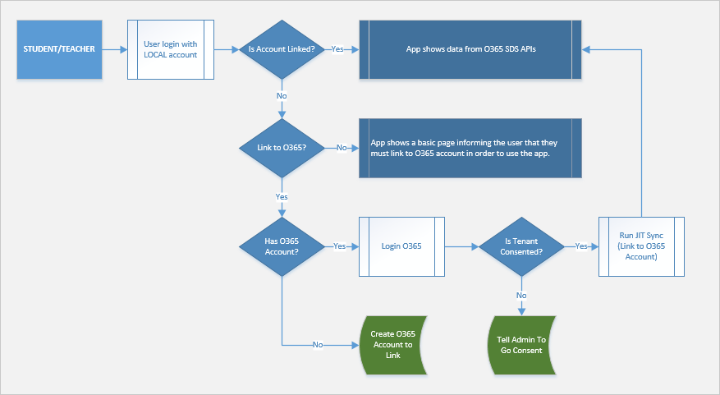

Slide 27
Auth scenarios
O365 Login
Users login in with accounts provided by Azure AD.

Slide 28
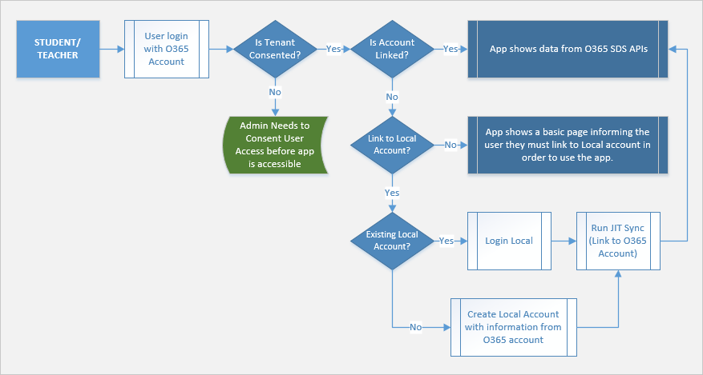

Slide 29
Auth scenarios
Admin Login
Administrators login in with their local or O365 account.

Slide 30
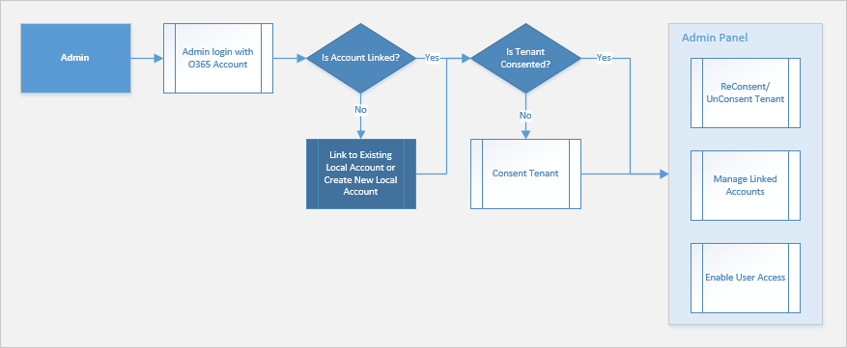

Slide 31
Auth scenarios
App Login
A daemon or server app (like a Web Job) could be authenticated by a certificate.
No user interaction is involved.

Slide 32
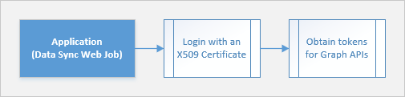

Slide 33
Curated EDU Samples

Slide 34
EDU Samples
Microsoft Azure - Azure Code Samples
GitHub – Azure Active Directory

Slide 35
Adding an Azure Active Directory (AAD) application to AAD with the Ibiza portal

Slide 36
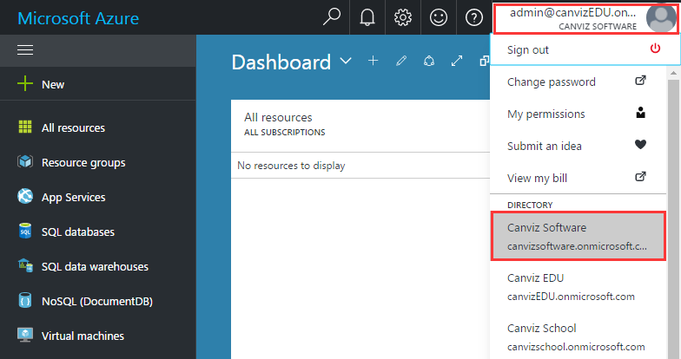
Sign into the Azure Portal: https://portal.azure.com/
Choose your Azure AD tenant by selecting your account in the top right corner of the page.

Slide 37
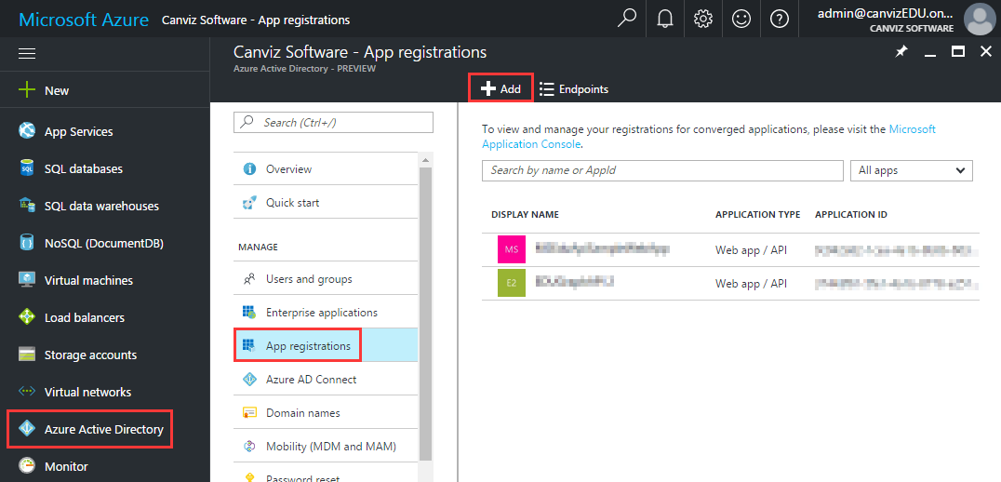
Click Azure Active Directory -> App registrations -> +Add

Slide 38
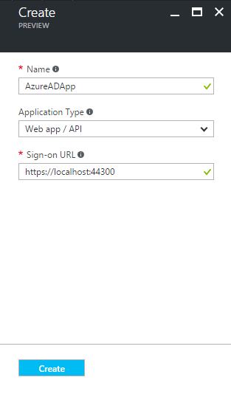
Follow the prompts and create a new application.
For Web Applications, provide the Sign-On URL, which is the base URL of your app, where users can sign in e.g https://localhost:44300.
For Native Applications, provide a Redirect URI, which Azure AD uses to return token responses. Enter a value specific to your application, .e.g http://MyFirstAADApp

Slide 39
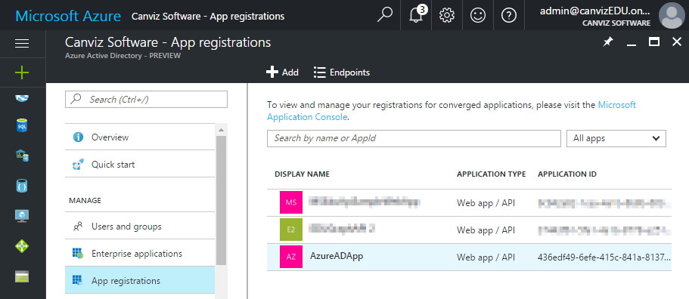
Once completed, the app registration appears in the list.
Click it to view its details.

Slide 40
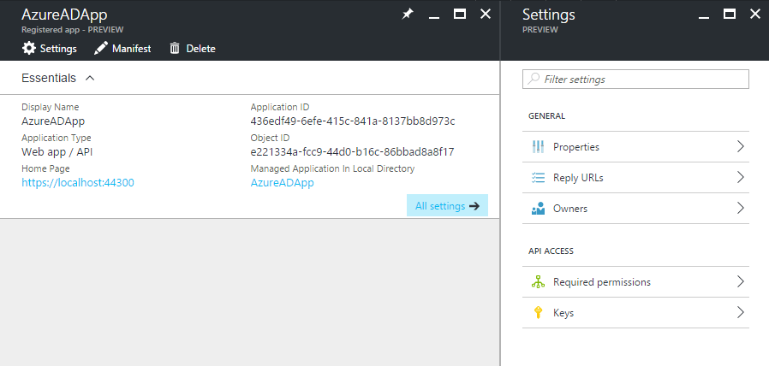
Click All settings

Slide 41
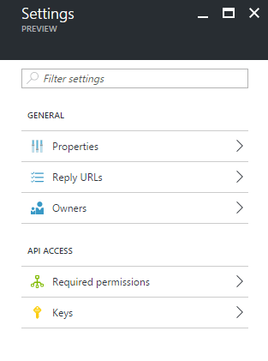
The Properties page lets you modify the general information for the application. This includes the application name, the sign-on URL, and the logout URL.
The Reply URLs page allows you to add a reply URL, which is where Azure AD sends token responses.
The Owners page allows you to add application owners.
The Permissions page allows you to configure permissions for the app. For example, to access the MS Graph API, click Add and select Microsoft Graph in the API selector, then choose the permission required, for example Read Directory Data.
The Keys page allows you to add application secrets. The secret will only be displayed once immediately after creation, so make sure to copy it for further use.

Slide 42
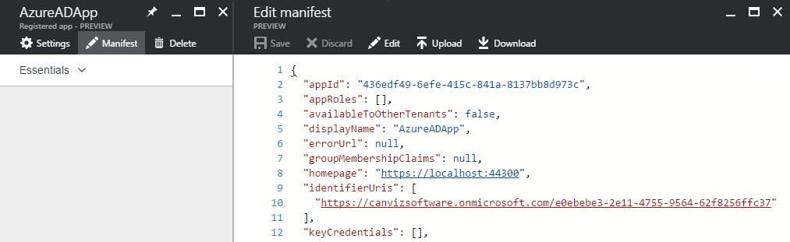
You can use the inline manifest editor to modify certain application properties that are not exposed directly in the Azure portal. Click Manifest..
You can directly make changes to the manifest and save it when you're ready. Alternatively, you can download the manifest to open it in your favorite editor and upload the updated manifest.

Slide 43
Appendix

Slide 44
Next Steps
Have your app appear in the Office 365 app launcher so students and teachers can easily access your solution from the Office 365 online portal
Review and follow our branding guidelines

Slide 45
Resources
What is Azure Active Directory?
Azure Active Directory developer's guide
Azure Active Directory Authentication Protocols
Register your application with your Azure Active Directory tenant
Branding Guidelines for Applications

Slide 46
Additional Technical Resources
AAD Developer's Guide: https://azure.microsoft.com/en-us/documentation/articles/active-directory-developers-guide/#reference.
Stack Overflow - If you are in need of assistance, please reference and add your issues to the forum… be sure to tag your entries with Azure-Active-Directory as the forum is monitored by engineering. We highly recommend posting your question to the forum first, and then sending us a link to your question in the forum so that we can follow up if there is no timely response.

